Slide 1

boredPosts
The best content sharing platform all around the web

Slide 2


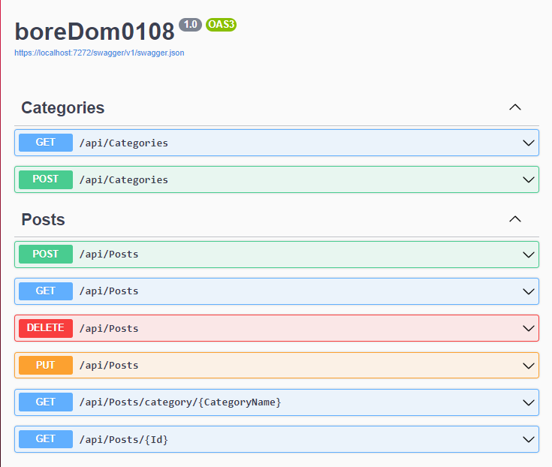
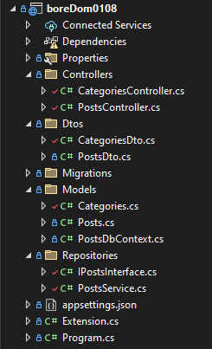
Asp:
Forgó Balázs

Slide 3
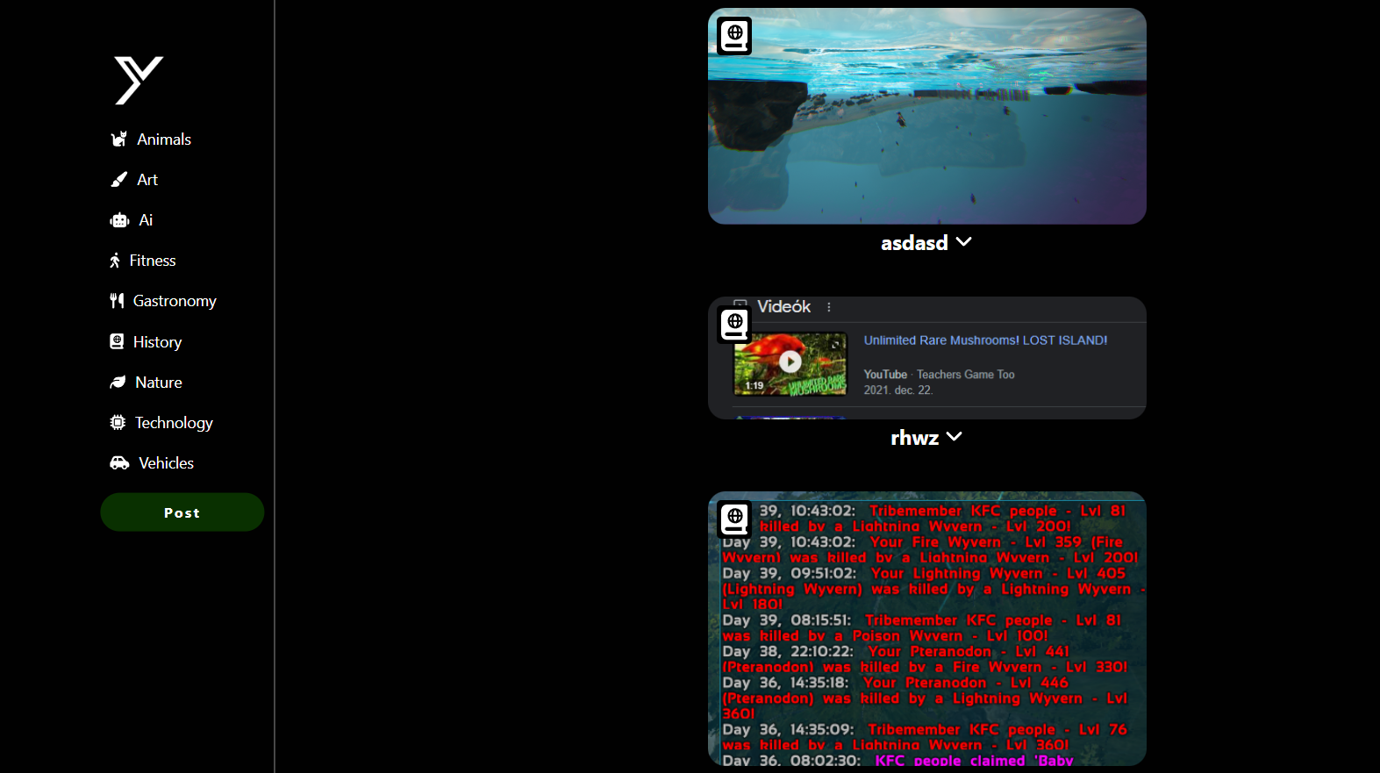
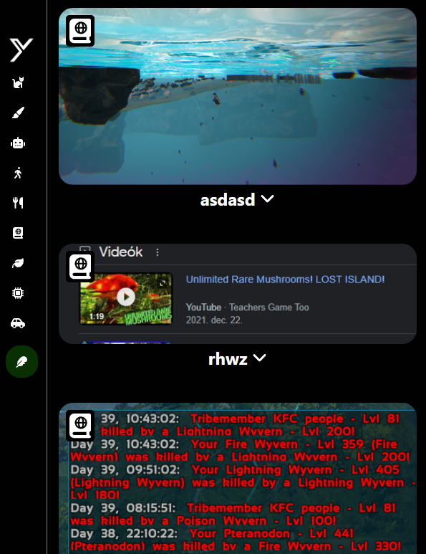
FrontEnd:
Ruszó Richárd

Slide 4
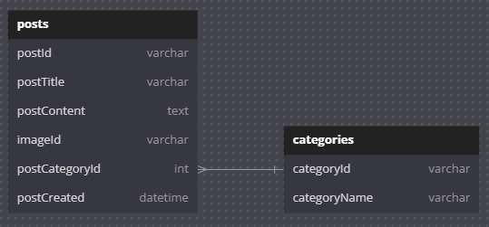

Design & Database:
Szegedi Bence Cs.

Slide 5
boredPosts
Still, the best The best content sharing platform all around the web

Slide 6
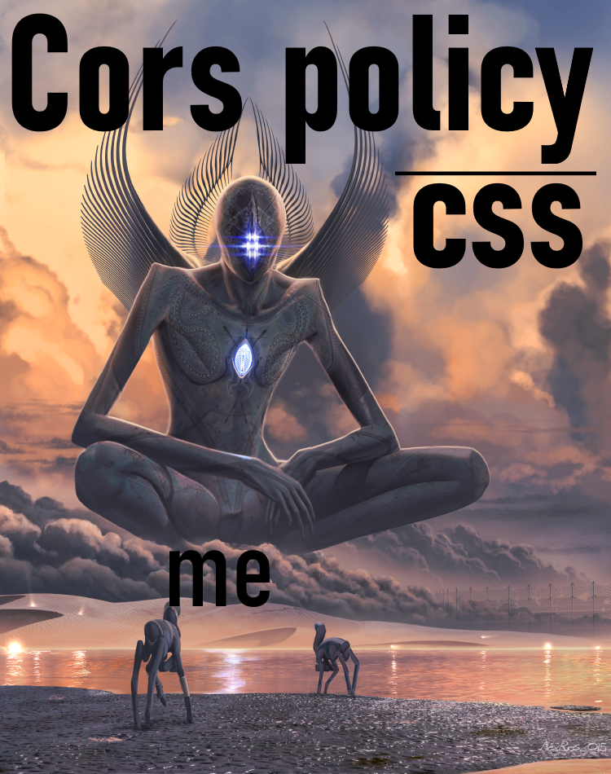

Slide 9
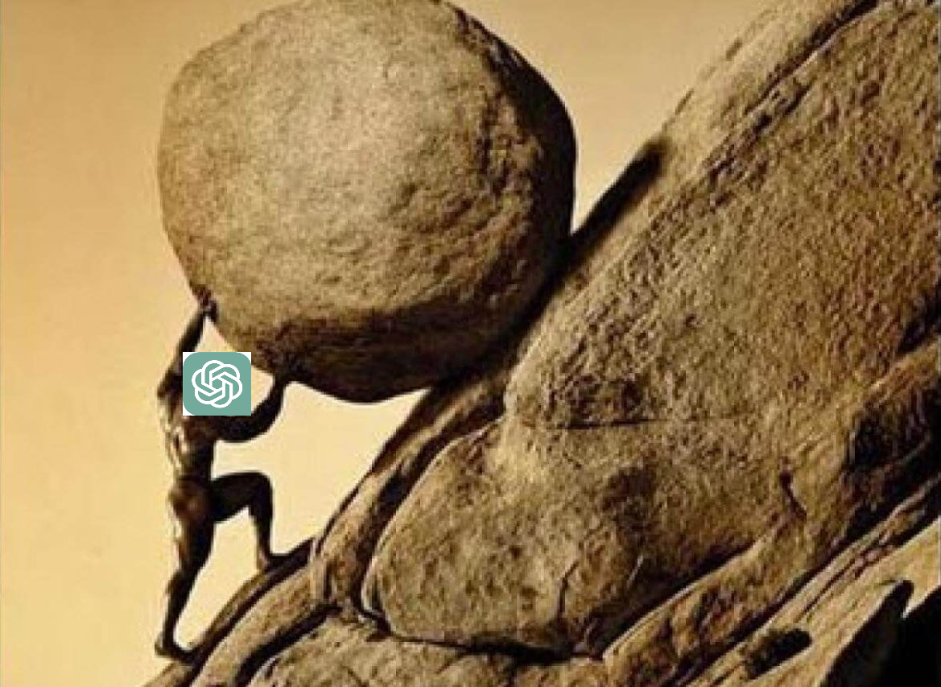
boreDom

